Slide 1

Diabetes Prediction with machine learning classification algorithms
Git-hub URL: https://github.com/Alikhalili56/ML_Diabetes-Prediction.git

Slide 2
Pima Indians Diabetes Database
Context
This dataset is originally from the National Institute of Diabetes and Digestive and Kidney Diseases. The objective of the dataset is to diagnostically predict whether or not a patient has diabetes, based on certain diagnostic measurements included in the dataset. Several constraints were placed on the selection of these instances from a larger database. In particular, all patients here are females at least 21 years old of Pima Indian heritage.
Content
The datasets consists of several medical predictor variables and one target variable, Outcome. Predictor variables includes the number of pregnancies the patient has had, their BMI, insulin level, age, and so on.

Slide 3
Data overview
https://www.kaggle.com/datasets/uciml/pima-indians-diabetes-database
We save our data in a csv file named : diabetes.csv

Slide 4
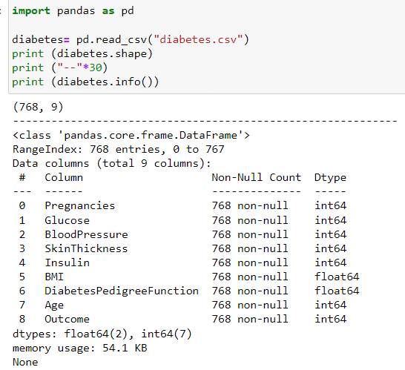
Data overview
The output shows that there are no missing values in the dataset and the data types of the columns are either integers or floats.

Slide 5
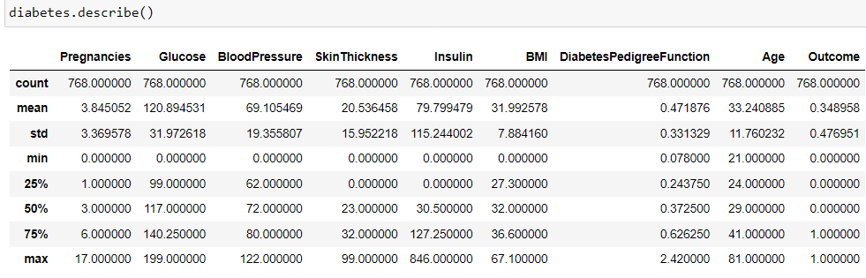









Data Quality Issues
The describe() method provides a statistical summary of the numerical columns of the "diabetes" dataset.
However, it is important to note that some columns have a minimum value of zero, such as "Glucose", "Blood Pressure", "Skin Thickness", "Insulin", and "BMI". These values are unlikely to be accurate and may indicate missing or incomplete data that needs to be addressed before using the dataset for machine learning.

Slide 6
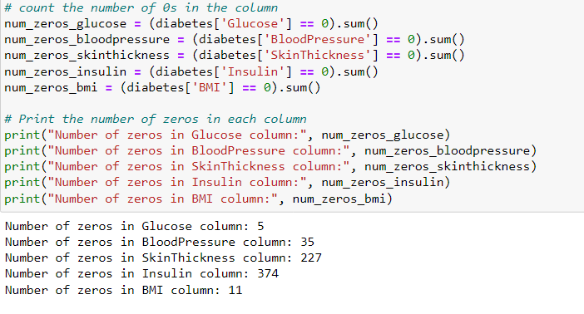
Data Quality Issues
Now, we can see the problem. I am not a doctor but I imagine that having a Blood Pressure of 0 is equivalent to be dead. Also, a Skin Thickness, insulin, glucose or BMI of 0 do not correlate good with the fact of being a living being.
Because of that, the data is NOT clean, and we need to take action.

Slide 7
Cleaning Data
Before building our model we should clean the data: I tried 2 different methods:
1- Deleting some rows consisting 0 values in Glucose, Blood Pressure or BMI using EXCEL. 2- Replacing rows with 0 values in Glucose, Blood Pressure, BMI, Skin Thickness, Insulin with the median values.
But, first we are going to train our Random Forest model with uncleaned data then compare the model that trained with cleaned data.

Slide 8
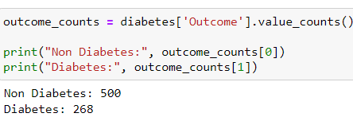
Data outcome distribution
Is our dataset balanced?
This is an example of imbalanced data, where the Diabetes class has significantly fewer samples than the Non-Diabetes class and the Non-Diabetes class is dominant. Specifically, the Diabetes class represents only around 35% of the total dataset, while the Non-Diabetes class represents around 65%.
This imbalance can pose challenges for machine learning algorithms because they may have difficulty identifying the minority class, in this case, the Diabetes class.

Slide 9
Possible Approaches
We consider 2 Approaches:
Training algorithms that might also work well with imbalanced data such as: Random Forest, Support Vector Machine (SVM), KNN, Gradient Boosting, Nural Networks, ...
In addition to these algorithms, various preprocessing techniques such as oversampling, under sampling, and data augmentation can also be used to handle imbalanced data.

Slide 10
The algorithms under consideration for training in our study
Random Forest : Random Forest is an ensemble learning algorithm that combines multiple decision trees to create a powerful model for classification or regression. In this algorithm, each decision tree is constructed using a random subset of the features and the samples, and the final prediction is based on the average or majority vote of the predictions of the individual trees.
Support Vector Classifier (SVC): Support Vector Classifier (SVC) is a type of Support Vector Machine (SVM) algorithm that is used for classification tasks. SVC is a supervised learning algorithm that works by finding the best possible hyperplane in a high-dimensional space that separates the different classes.
K-Nearest Neighbors (KNN): K-Nearest Neighbors (KNN) is a popular supervised machine learning algorithm used for both classification and regression tasks. It is a non-parametric, lazy learning algorithm that works based on the concept of similarity between data points.

Slide 11
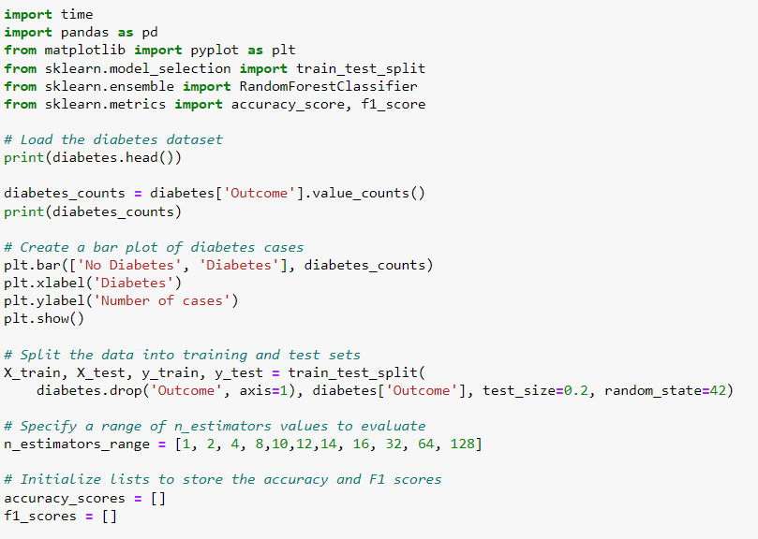
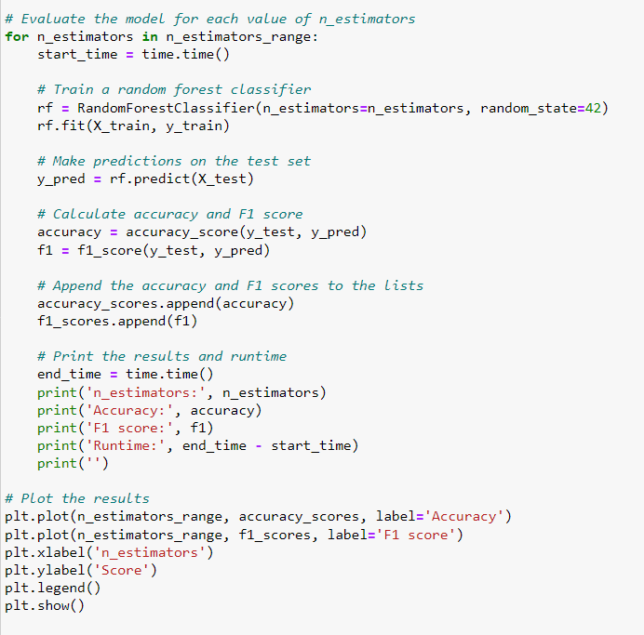
Training Random Forest classifier with Uncleaned Diabetes Data

Slide 12
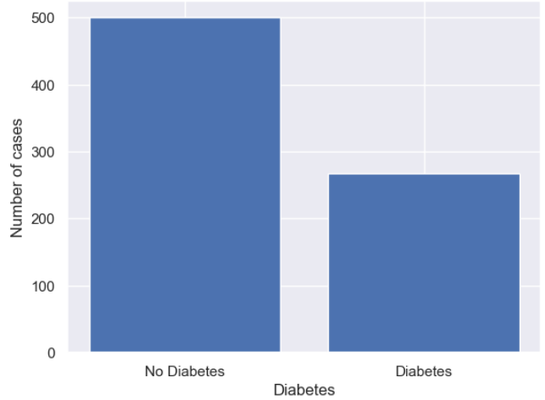
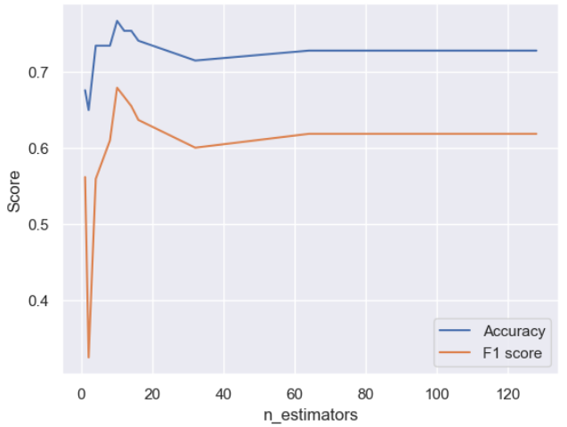
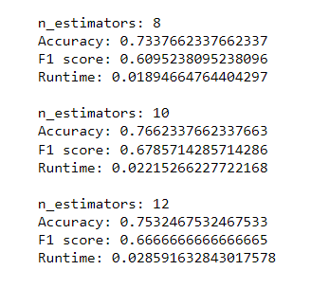
Output

Slide 13
Comparing Different evaluation metrics
Accuracy, Precision, recall, and F1-score are metrics used in binary classification problems to evaluate the performance of a model. They are based on the confusion matrix, which is a table showing the number of true positives, false positives, true negatives, and false negatives.
Precision = True Positives / (True Positives + False Positives)
Recall = True Positives / (True Positives + False Negatives)
F1-score = 2 * (Precision * Recall) / (Precision + Recall)
Accuracy = (true positives + true negatives) / (true positives + false positives + true negatives + false negatives)

Slide 14
F1 vs Accuracy
F1 score is a measure of the balance between precision and recall, which are both important metrics in classification problems. It considers both false positives and false negatives and provides a single score that summarizes the model's performance. F1 score is a better metric than accuracy in situations where there is class imbalance (like our case), that is when the number of observations in each class is not equal. This is because accuracy can be misleading in such situations, as it can be high even if the model performs poorly on the minority class.
Accuracy, on the other hand, measures the proportion of correctly classified observations among all the observations. It is a good metric to use when the classes are balanced and there are no costs associated with misclassification. However, accuracy alone may not be a sufficient metric when the costs of false positives and false negatives are different.

Slide 15
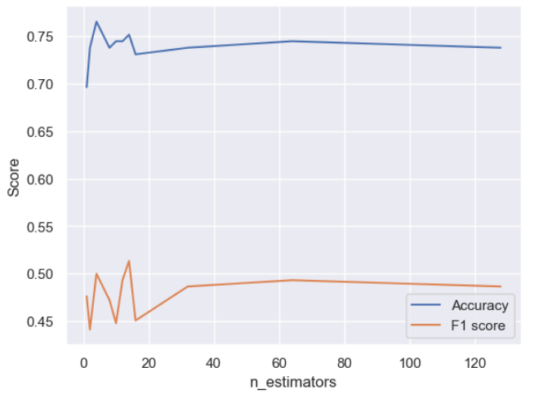
Training Random Forest with cleaned data that Features with "0" values omitted
We used the same Random Forest algorithm to train this updated data, however, as we can observe the F1 score of the model drops dramatically, but why?
The F1 score is a metric that measures the balance between precision and recall of a binary classification model. Cleaning the data, i.e., removing some rows with values of 0, can have an impact on the F1 score if the removed rows contain significant information that the model requires for making accurate predictions.
For example, if the rows with values of 0 that were removed represented a certain subgroup of the population that had a higher incidence of diabetes, then removing those rows could lead to a drop in the F1 score since the model would no longer be able to capture the characteristics of that subgroup.

Slide 16
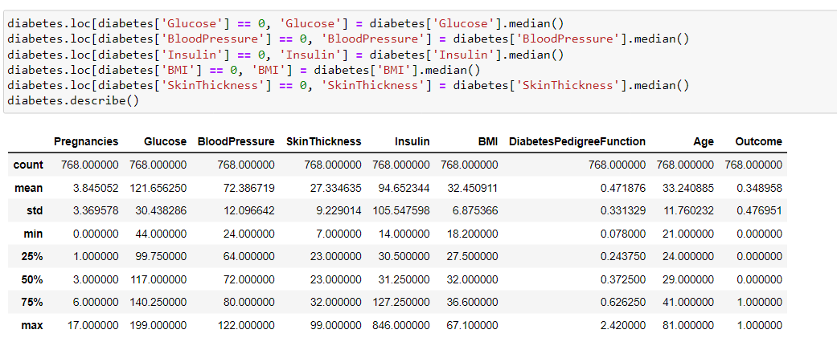
Replacing "0" values by median values

Slide 17
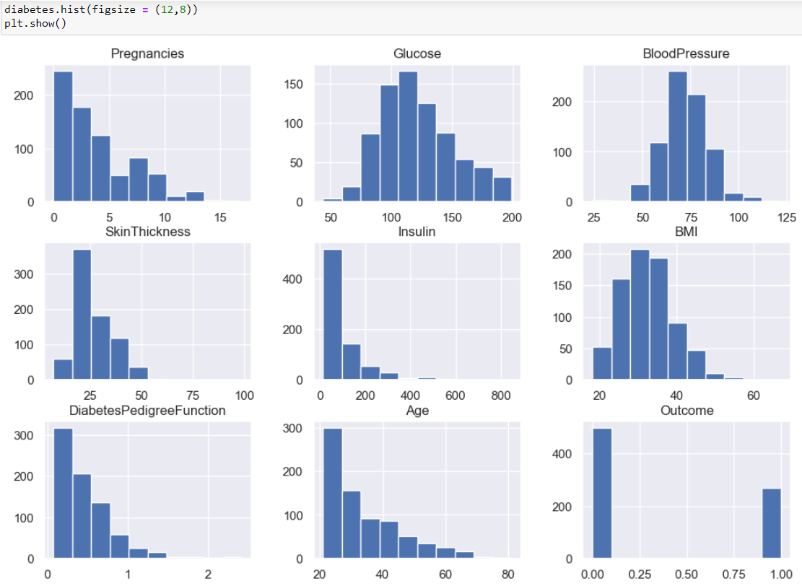
Histograms of Diabetes Dataset Features.

Slide 18
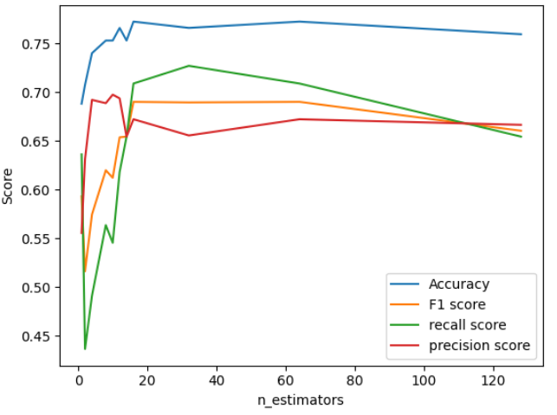
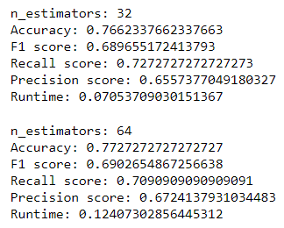
Training Random Forest with cleaned data that 0 values replaced by median values
As it is observable we have decent Accuracy, and also F1_score for number of n estimators in range of 16 to 64

Slide 19
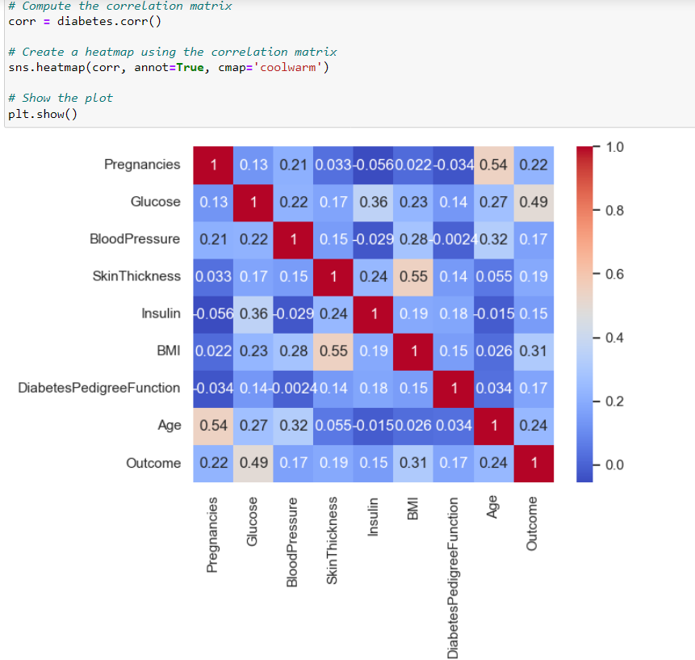
Correlation matrix
A correlation matrix is a table that shows the correlation coefficients between pairs of variables in a dataset. Each cell in the table represents the correlation between two variables, with values ranging from -1 to +1.
A correlation coefficient of +1 indicates a perfect positive correlation, meaning that when one variable increases, the other variable increases as well. A correlation coefficient of -1 indicates a perfect negative correlation, meaning that when one variable increases, the other variable decreases. A correlation coefficient of 0 indicates no correlation between the variables

Slide 20
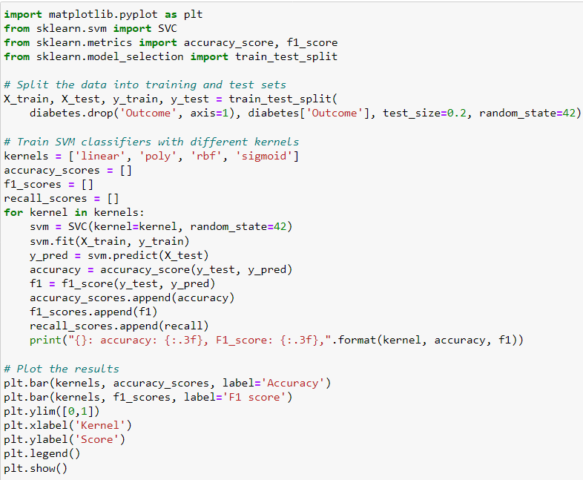
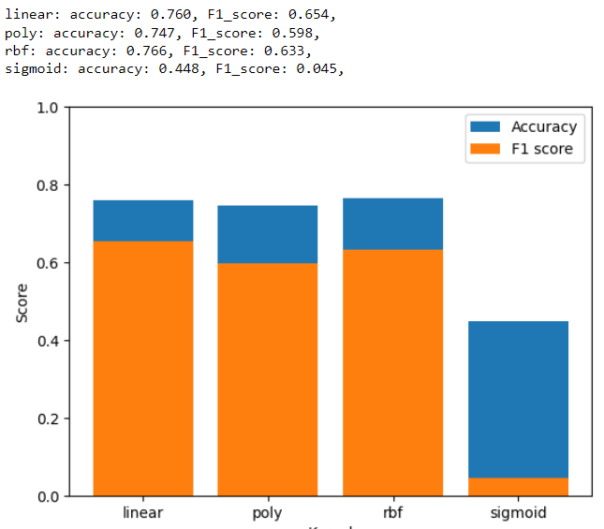
Training SVC algorithm with diabetes data

Slide 21
4 Types of SVC kernels
Linear Kernel: The linear kernel is the simplest kernel function, and it assumes that the data is linearly separable. It works well when the data is linearly separable, and it is computationally efficient.
1
Polynomial Kernel: The polynomial kernel function maps the input data into a higher-dimensional feature space by using a polynomial function. This kernel function can capture non-linear relationships between the input features, but it is more computationally expensive than the linear kernel.
2
Radial Basis Function (RBF) Kernel: The RBF kernel function is the most commonly used kernel in SVMs. It maps the input data into a higher-dimensional feature space using a Gaussian function. This kernel can capture complex non-linear relationships between the input features, but it is also computationally expensive.
3
Sigmoid Kernel: The sigmoid kernel function maps the input data into a higher-dimensional feature space using a sigmoid function. It can be used for non-linear classification problems, but it is less commonly used than the linear, polynomial, and RBF kernels.
4

Slide 22
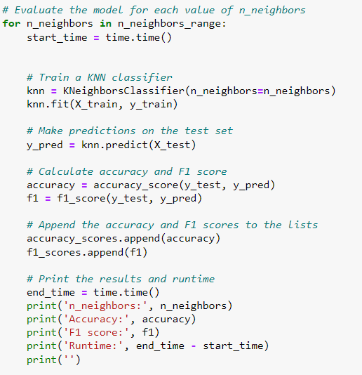
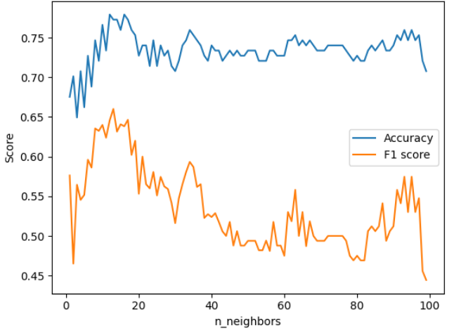
Training KNN classifier with diabetes data

Slide 23
Why the performance of KNN is so poor?
KNN is a simple algorithm that relies on the distance between samples to make predictions. In an imbalanced dataset, the nearest neighbors of a sample are likely to belong to the majority class, and the model may predict that class for the sample. This can result in poor performance, as the minority class is not well represented in the training data.
To address this issue, resampling techniques such as oversampling or under sampling can be used to balance the dataset. Oversampling involves increasing the number of instances of the minority class, while under sampling involves decreasing the number of instances of the majority class. This can help the model learn more about the minority class and improve its performance.
In our case, it is likely that resampling the data helps to balance the classes and improve the performance of the KNN model. By increasing the number of instances of the minority class, the model may have learned more about the features that distinguish that class, and thus may make better predictions.

Slide 24
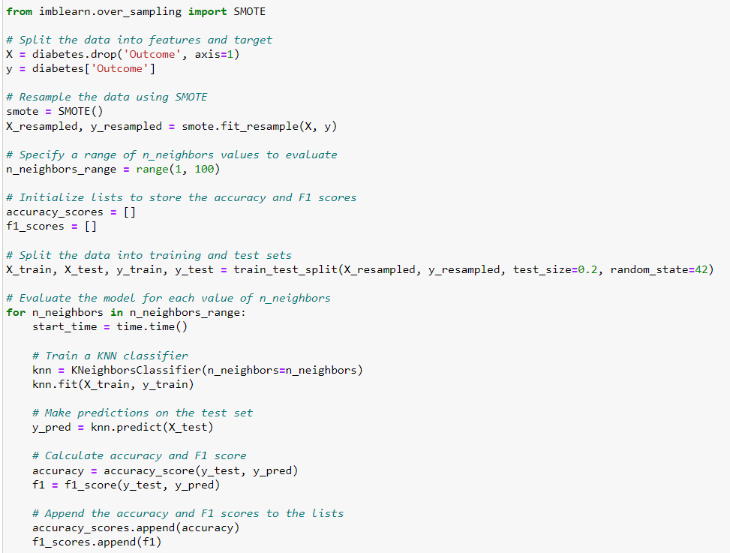
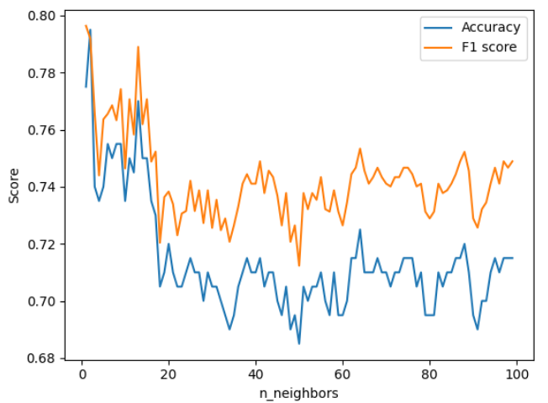
Training KNN with oversampling on data

Slide 25
Conclusion
We used 3 different classification algorithm to accurately predict whether or not a case has a diabetes or not.
First of all, to achieve a satisfying result with Random Forest we replaced all the cases with values that were equal to 0 with the median value of that feature among the total cases, consequently, the efficiency of the model increased.
Secondly, we trained Svc model with 4 different types of kernel, linear kernel worked well and rbf was not bad.
Finally, we trained a KNN model with our diabetes data, at first, the outcome was poor, then to improve the result we over sampled our dataset to make it balanced and consequently, the final score improved dramatically.

